Slide 1

Web scraping to gain company insights

Slide 2
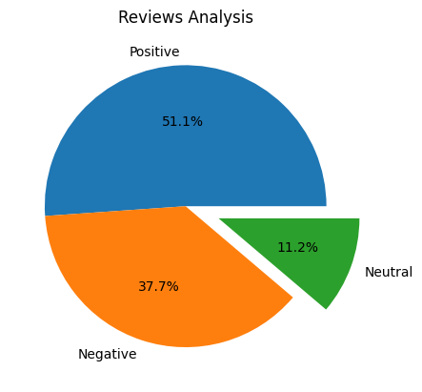
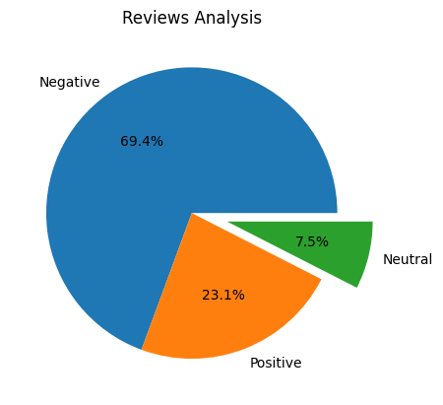
INSIGHTS FROM CUSTOMER REVIEWS
From cleaning 3800 reviews given by the customers and removing null values, we obtained
Using NLTK Library | Using Transformer
Positive Reviews - 1178 Negative Reviews - 869 Neutral Reviews – 258 | Positive Reviews - 533 Negative Reviews - 1600 Neutral Reviews – 173

